Slide 1

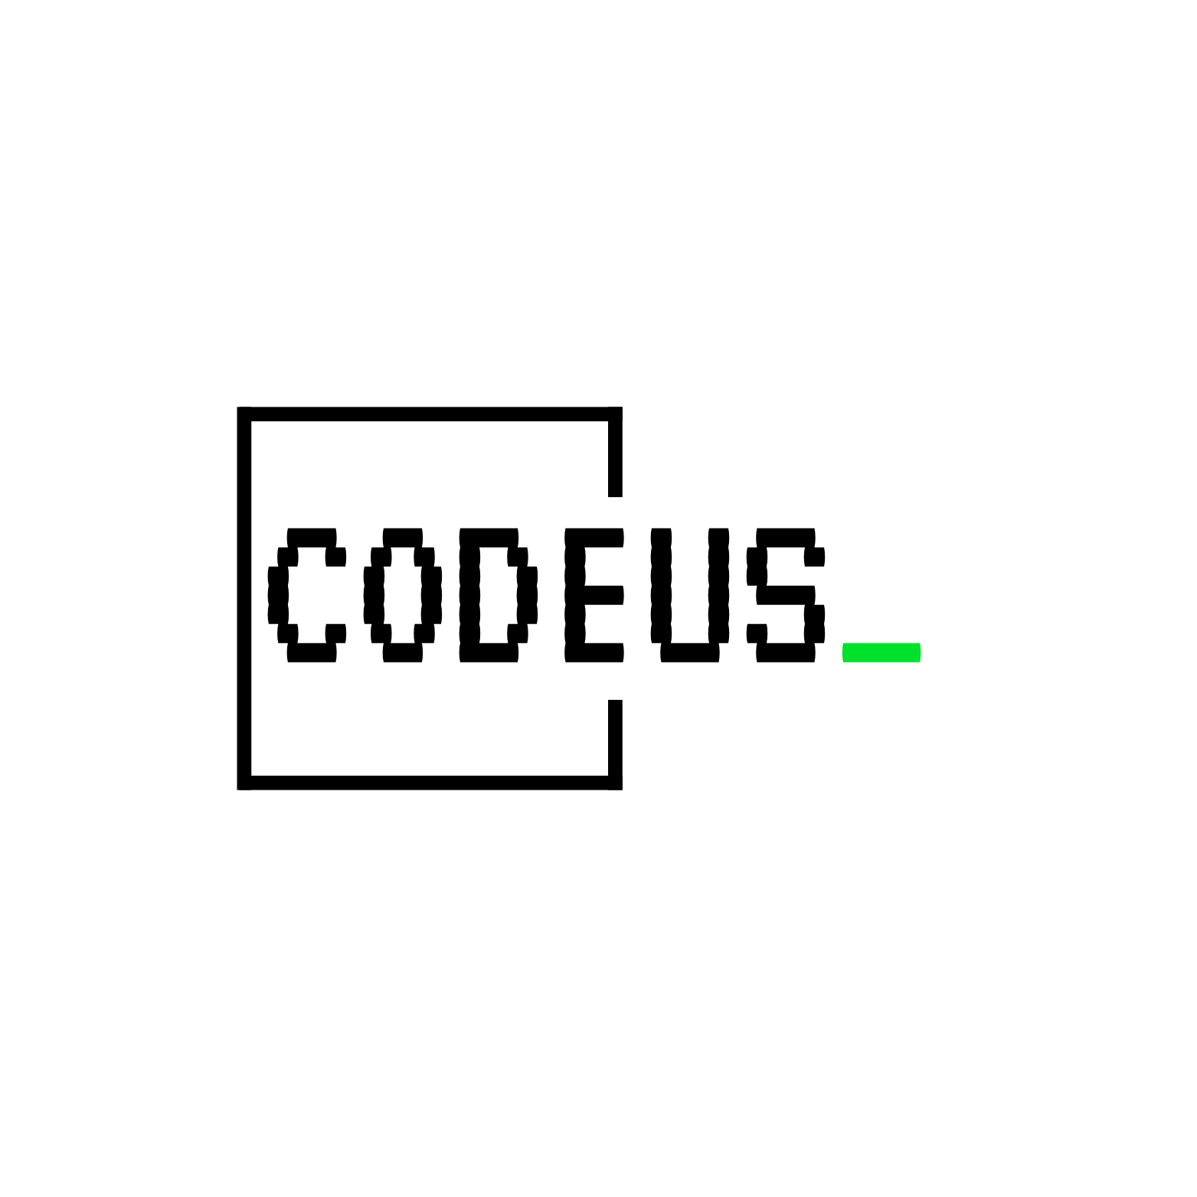
Docker basic usage

Slide 2


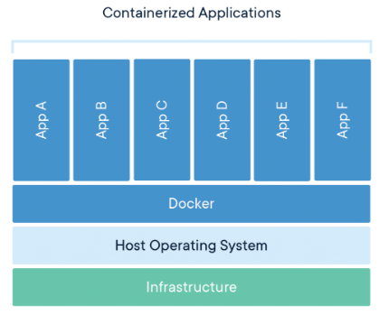
Containerization
Container is a standard unit of software that packages up code and all its dependencies so the application runs quickly and reliably from one computing environment to another.
A Docker container image is a lightweight, standalone, executable package of software that includes everything needed to run an application: code, runtime, system tools, system libraries and settings.

Slide 3
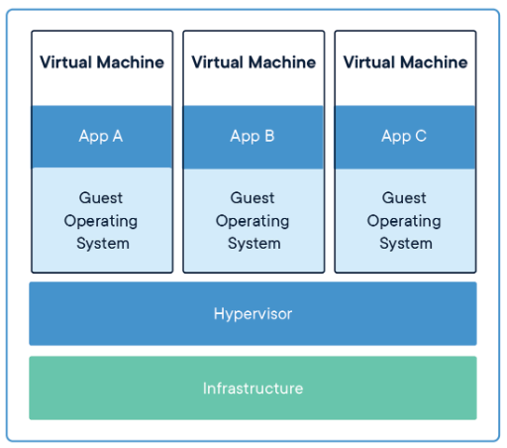
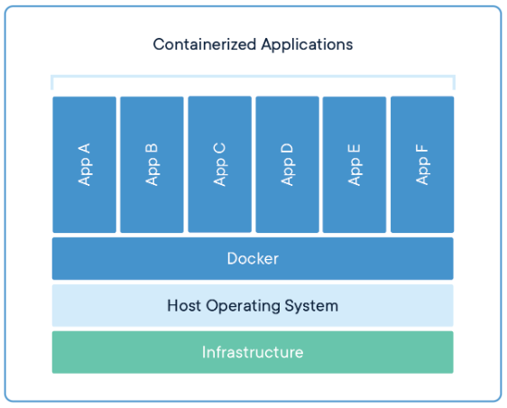
Containers vs. Virtual Machines
abstraction at the app layer that packages code and dependencies together
run multiple containers as isolated processes
less space than VMs
abstraction of physical hardware turning one server into many servers.
each VM includes a full copy of an operating system, the application, necessary binaries and libraries. Takes up a lot of space
can be slow to boot

Slide 4
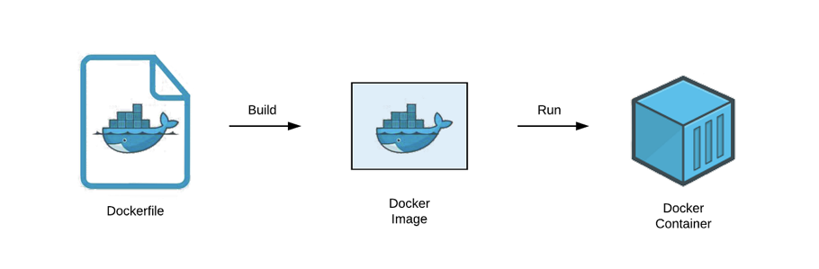
Dockerfile, Image, Container
Dockerfile contains a source code for a Docker image creation
Docker image is a blueprint with instructions for a container creation. Like a recipe including code, libraries, environment needed to run your application

Slide 5
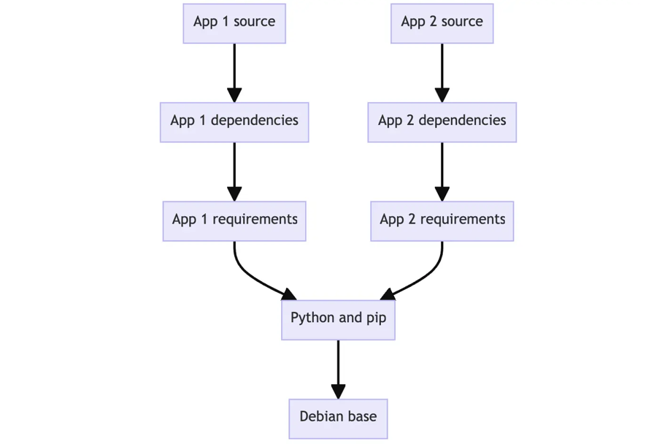
Image Layers
An image is composed of layers. Each Dockerfile instruction corresponds to a separate layer.
Each layer in an image contains a set of filesystem changes - additions, deletions, or modifications.
The usage of immutable layers helps containers to be lightweight and reuse the same base images.

Slide 6
Dockerfile, Image, Container
Dockerfile contains a source code for a Docker image creation
Create a Dockerfile
Create a Dockerfile

Slide 7
Dockerfile, Image, Container
Dockerfile contains a source code for a Docker image creation
Docker image is a blueprint with instructions for a container creation. Like a recipe including code, libraries, environment needed to run your application
Create a Dockerfile
Command example:
docker build -t my-app:1.0 .
Build the image

Slide 8
Dockerfile, Image, Container
Dockerfile contains a source code for a Docker image creation
Docker image is a blueprint with instructions for a container creation. Like a recipe including code, libraries, environment needed to run your application
Create a Dockerfile
Command example:
docker build -t my-app:1.0 .
Build the image
Build the image
Start a Docker container based on the image
Run the container
Command example:
docker run -p 8080:8080 -d —-rm —-name app-container my-app:1.0

Slide 9

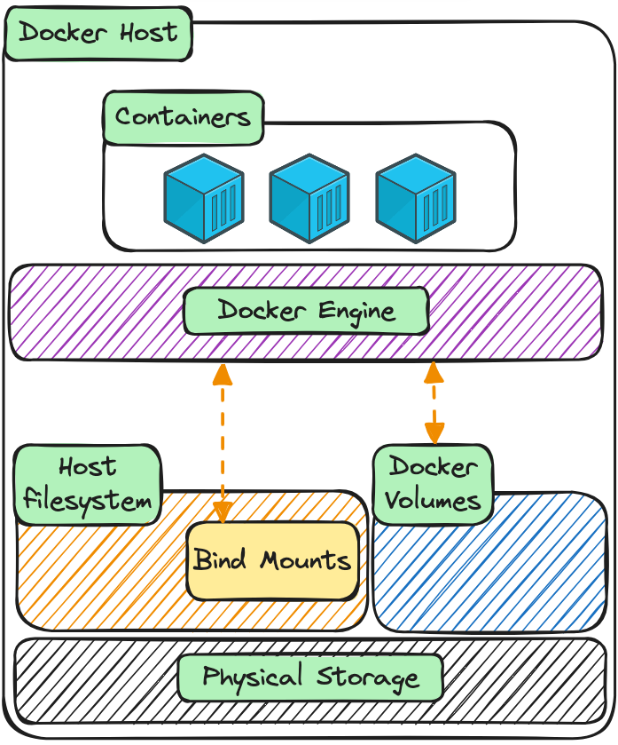
Bind mounts
Bind mount is a way to mount a file of directory on host into a container. This leads to a container being able to access the file/directory from your host.
Bind mounts are often used when:
you need to create files in container and persist them on host
you need to share configuration files from the host machine to containers
Considerations:
bind mounts have write access to files on the host by default. Use readonly or ro option to prevent it when needed
containers with bind mount are strongly tied to the host. The container may fail if run on a different host with different directory structure
Example:
docker run -dit --name my-apache-app -p 8080:80 -v “$PWD”:/usr/local/apache2/htdocs/:ro httpd:2.4
Alternatives:
Volumes
tmpfs mounts

Slide 10
Useful commands cheatsheet
Command | Options | Description | Example
pwd |  | Print working directory | pwd
ls [directory] |  | List directory contents | ls /
 | -R | Recursively list subdirectories | ls -R ~/Downloads
cat [file] |  | Concatenate and print files | cat index.html
docker build [options] PATH |  | Build an image from Dockerfile | docker build -t app:1.0 .
 | -t, --tag | Name and optionally tag in the name:tag format
docker run [options] IMAGE [command] [arg…] |  | Create and run a new container from an image | docker run --name test -d nginx:alpine
 | -d, --detach | Run a container in background and print container ID | -d
 | -i, --interactive | Keep STDIN open even if not attached | --interactive --tty
 | -t, --tty | Allocate a pseudo-TTY | -it
 | --name | Assign a name to the container | --name test
 | -p, —publish | Publish a container's port(s) to the host in in the host_port:container_port format | -p 80:8080
 | --rm | Automatically remove the container and its associated anonymous volumes when it exits | --rm
 | -v, --volume | Bind mount a volume | -v $(pwd):$(pwd)

Slide 11
Useful commands cheatsheet
Command | Options | Description | Example
docker exec [options] CONTAINER COMMAND [args…] |  | Execute a command in a running container | docker exec -it my-container bash
 | -i, --interactive | Keep STDIN open even if not attached | --interactive --tty
 | -t, --tty | Allocate a pseudo-TTY | -it
docker logs |  | Fetch the logs of a container | docker logs my-container
 | -f ,--follow | Follow log output | -f

Slide 12

Thank you
Author: Yevhenii Savonenko
My LinkedIn: www.linkedin.com/in/yevhenii-savonenko-624a32172
Date: January 2025
Join Codeus community in Discord
Join Codeus community in LinkedIn

